Slide 1

BLOCKCHAIN
Basic Concepts and
Definitions
Sunitha R
Department of Computer Science Engineering

Slide 2

BLOCKCHAIN
Blockchain key concepts
Sunitha R
Department of Computer Science Engineering

Slide 3
BLOCKCHAIN
Learning Content
Get the basic idea of blockchain with different components of it
Learn about the importance of Node component in blockchain and various types.

Slide 4
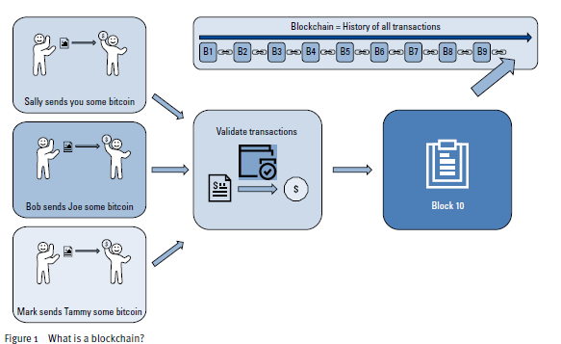
BLOCKCHAIN
Concept
Notes:
Blockchain technology has come a long way since the initial vision published by Satoshi Nakamoto in the Bitcoin white paper in 2008.
The author, Satoshi Nakamoto wanted to create a peer-to-peer electronic cash system that did not need a network of banks to operate.
Satoshi described “blocks” and “chains” as a way of organizing and securing records, such that once entries had been made into a shared database, they could be proved mathematically correct and to have remained unchanged.
Blockchain software becomes the trusted record-keeping systems, and the rules programed into the software become the intermediaries.
It is important to note that blockchains can be used for more than just recording the transfer of value between two parties.
The primary benefits of cryptographic identity, historical and chronological provenance, and the transparency of the networks complete history work exceptionally well for many industries that require two parties to trust each other.

Slide 5
BLOCKCHAIN
Key Concepts
Nodes
Blocks
Transactions
Cryptocurrency
Tokens
Public Ledger
Peer to peer Network
Notes:
Blockchain technology has come a long way since the initial vision published by Satoshi Nakamoto in the Bitcoin white paper in 2008.
The author, Satoshi Nakamoto wanted to create a peer-to-peer electronic cash system that did not need a network of banks to operate.
Satoshi described “blocks” and “chains” as a way of organizing and securing records, such that once entries had been made into a shared database, they could be proved mathematically correct and to have remained unchanged.
Blockchain software becomes the trusted record-keeping systems, and the rules programed into the software become the intermediaries.
It is important to note that blockchains can be used for more than just recording the transfer of value between two parties.
The primary benefits of cryptographic identity, historical and chronological provenance, and the transparency of the networks complete history work exceptionally well for many industries that require two parties to trust each other.

Slide 6
BLOCKCHAIN
Nodes
A computer connects to a blockchain network, the computer becomes a node.

Slide 7
BLOCKCHAIN
Types of Node
Full Node
Light Weight Node
Miner

Slide 8
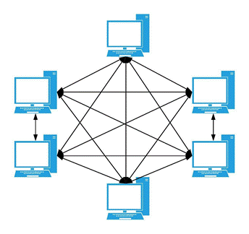
BLOCKCHAIN
Full Node
A full node is a node that downloads all blocks and transactions to its local storage
It has all blocks and transactions
It is a fully independent node on a blockchain network
It can provide blocks and transactions to other nodes
It can get new blocks and transactions from other nodes
It can verify all blocks

Slide 9
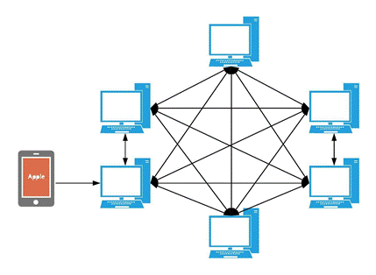
BLOCKCHAIN
Light Node
Has block headers and some transactions
Has a pair of private/public keys
Uses SPV to verify transactions

Slide 10
BLOCKCHAIN
Miner
Miner is a computer that helps in creating blocks for a Blockchain network.
Mining was done by a full node with full node software, such as Bitcoin.
The mining process takes a lot of CPU power, so developers changed it to use GPU.

Slide 11
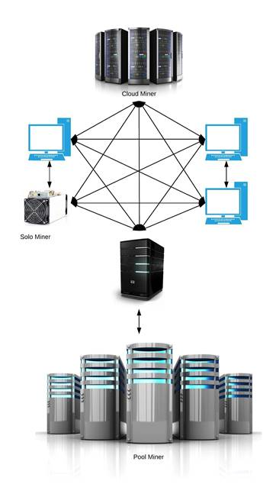
BLOCKCHAIN
Miner Node

Slide 12
BLOCKCHAIN
Other Kind of Nodes
Other Kind of Nodes are
Public Blockchain Nodes
Permissioned blockchain nodes
Nodes on a Corda Network
Nodes on Hyperledger Fabric Network
Federated Blockchain Nodes

Slide 13
BLOCKCHAIN
Public Blockchain Nodes
It is open for anyone in the world
Any node can be full node, light weight node and miner
No gating mechanism
No need of permission
No licencing fees

Slide 14
BLOCKCHAIN
Permissioned blockchain nodes
Know entities
No native cryptocurrency
Most do not incorporate mining

Slide 15
BLOCKCHAIN
Nodes on a Corda Network
Corda is a distribute ledger blockchain technology.
It s a protocol works behind R3.

Slide 16
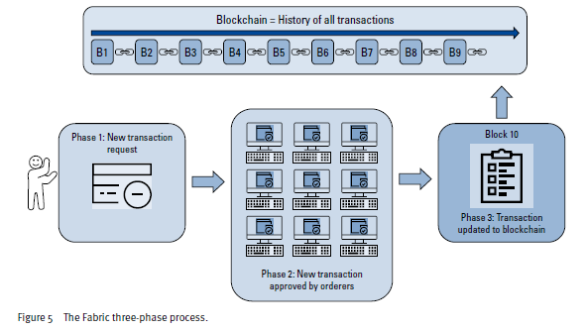
BLOCKCHAIN
Nodes on Hyperledger Fabric Network

Slide 17
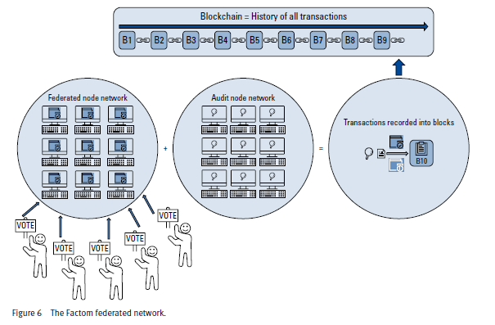
BLOCKCHAIN
Federated Blockchain Nodes

Slide 18
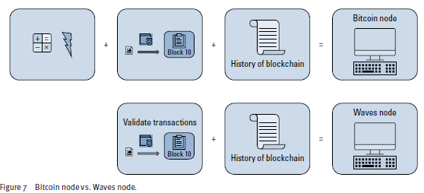
BLOCKCHAIN
Difference between Bit coin node and Wave node

Slide 19
BLOCKCHAIN
Supplementary readings
https://bitcoin.org/en/full-node
https://nodes.com/

Slide 20
THANK YOU
Sunitha R
Department of Computer Science Engineering
sunithar@pes.edu
+91 80 6666 3333 Extn 721

